Slide 1

Cost, Subsidy and Access in Public Higher Education
David H Feldman
College of William and Mary
COSUAA Annual Meeting
San Francisco
April 29, 2012

Slide 2
Notes:
Forces Driving Cost: Technological changes that are reshaping the entire US economy.
Overall trend is cost disease. Recent rise is college wage gap. Down portion is great productivity slowdown.
This is not the cause of affordability problems.

Slide 3
Notes:
From the BLS data used in “Explaining Increases in Higher Education Costs,” JHE 2008..

Slide 4
The Technological Forces Behind Rising College Cost
1. Baumol’s Cost Disease
3. Standard Of
Care
2. The College Wage
Premium
The Tripod

Slide 5
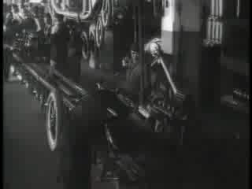
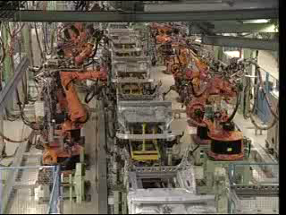
1. Cost Disease
Some things change a lot.
Notes:
The is the work of William Baumol and William Bowen. Taylor Reveley was a research assistant on that project.

Slide 6
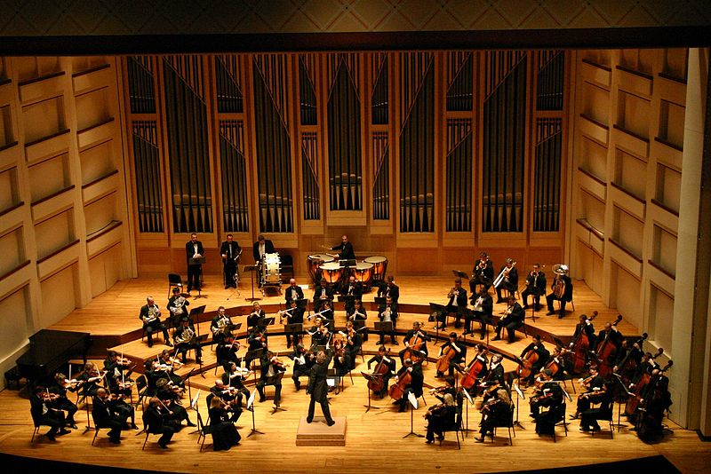
Some things don’t …

Slide 7
Notes:
Services is broad. It includes barbers as well as doctors, lawyers, and higher education.

Slide 8
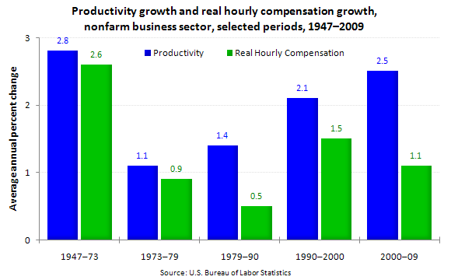
Productivity and Wages
Notes:
Source: Bureau of Labor Statistics

Slide 9
Notes:
Forces Driving Cost: Technological changes that are reshaping the entire US economy.
Overall trend is cost disease. Recent rise is college wage gap. Down portion is great productivity slowdown.
This is not the cause of affordability problems.

Slide 10
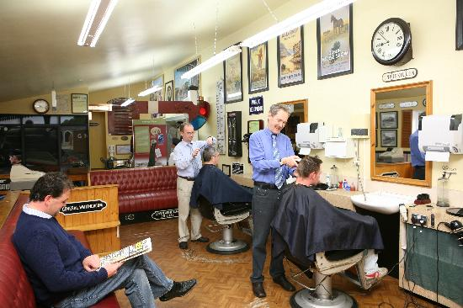
2. The Costs of Employing Highly Educated Labor
Why do college costs rise more rapidly than the price of barbers’ services?

Slide 11
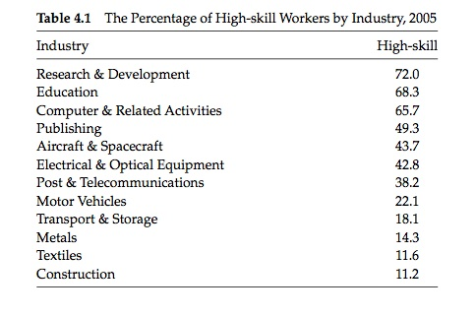

Slide 12
Wages of High Skilled Workers

Slide 13
Notes:
Forces Driving Cost: Technological changes that are reshaping the entire US economy.
Overall trend is cost disease. Recent rise is college wage gap. Down portion is great productivity slowdown.
This is not the cause of affordability problems.

Slide 14


3. Standard of Care

Slide 15
The Dysfunction Narrative
Waste at Colleges and universities
        Useless research
    Administrative bloat
    Tenure and lazy professors
    Country Club U
Notes:
Three Issues:
Can one find seemingly undesirable examples of these things? Yes. Colleges and universities are not perfectly lean enterprises.
What is the context?
Are they the important drivers of the pattern of tuition increase? No.

Slide 20
Has a College Education Become Less Affordable?
Changes in Cost
Changes in Income
Changes in Subsidy

Slide 21
The percentage of the average person’s income spent on services has …. ?
Notes:
Services is broad. It includes barbers as well as doctors, lawyers, and higher education.

Slide 22
Notes:
In 2011 dollars.
If you take the income the US generates and spread it around equally, there is enough income to continue purchasing the college education, however much its cost is rising, and have increasing amounts of REAL INCOME left over for other things.

Slide 23
Notes:
In real 2011 dollars

Slide 24
The Forces Driving Changes in Affordability
State Subsidy
The roller coaster ride.
Heading downhill.
2. The National Distribution of Income
Rising inequality overall.
Increasing concentration at the very top.
3. Increasing tuition discounting.

Slide 25
Notes:
For individual states, the peak and the amount of downtrend is affected by political institutions: TELS and SMRs.

Slide 28
Notes:
In real 2010 dollars

Slide 29
Productivity and Wages
Notes:
Source: Bureau of Labor Statistics

Slide 31
Do Subsidies Drive up Tuition?

Slide 32
Simple Supply and Demand Analysis
P
S
D’
D
Q
Notes:
It’s simple Econ 101. Rising demand drives up cost.
But it’s not so simple when we’re not in a perfectly competitive market for homogeneous widgets.
And are instead in a not-for-profit world in which the “firms” carefully select their customers, and revenue is only one goal.

Slide 33
Subsidy from an Institutional Perspective
Pass it along to needy students as lower net price.
Reduce the school’s own need-based grants and use the extra resources to grow the endowment.
Reduce the school’s own need-based grants and use the resource to improve the quality of programming.
Cut back on tuition discounting, and lower the list price for everyone.
None of these choices causes list price tuition to rise.
Notes:
Does subsidy cause tuition increases?

Slide 34
Better Supply and Demand Analysis!
P
S’
S
D
D’
Q

Slide 35
Current Issues in Access and Affordability
Funding crisis for public higher education forces a choice between higher tuition and reduced quality.
Stagnant real incomes at most income levels drives the politics of higher education.
Tuition discounting is the institutional response at private universities, and is the future at many public universities.
But tuition discounting adds complexity and uncertainty, both of which impact access.
Notes:
Over the past ten years, we have seen a bit of both … higher tuition and reduced quality.

Slide 36
